Slide 1
Unit 1
Introduction
Software Engineering
CSIT 6th Semester

Slide 2
Syllabus
Unit 1: Introduction (2 Hrs.)
Software and its Types
Attributes of Good Software
Software Engineering and its Importance
Fundamental Software Engineering Activities
Difference between Software Engineering and Computer Science
Difference between Software Engineering and System Engineering
Challenges and Cost of Software Engineering
Professional Software Development
Software Engineering Diversity
Internet Software Engineering; Software Engineering Ethics

Slide 3
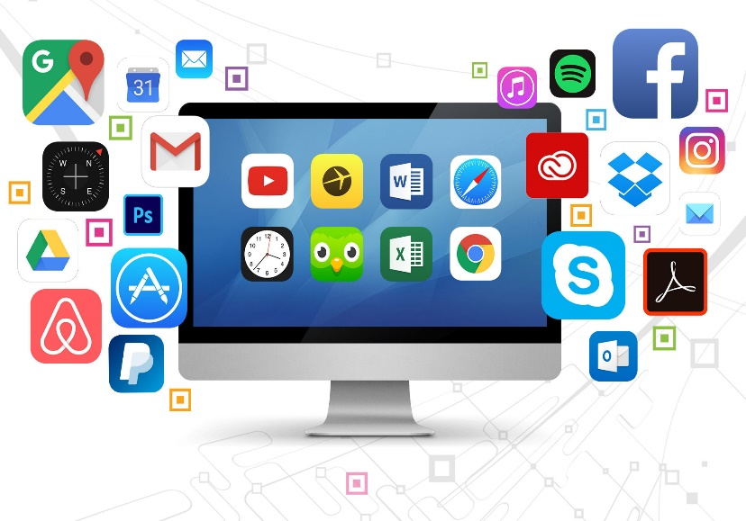
Software definition:
Software is a set of instructions, data or programs used to operate computers and execute specific tasks. It is the opposite of hardware, which describes the physical aspects of a computer.
Software is a generic term used to refer to applications, scripts and programs that run on a device. It can be thought of as the variable part of a computer, while hardware is the invariable part.

Slide 4
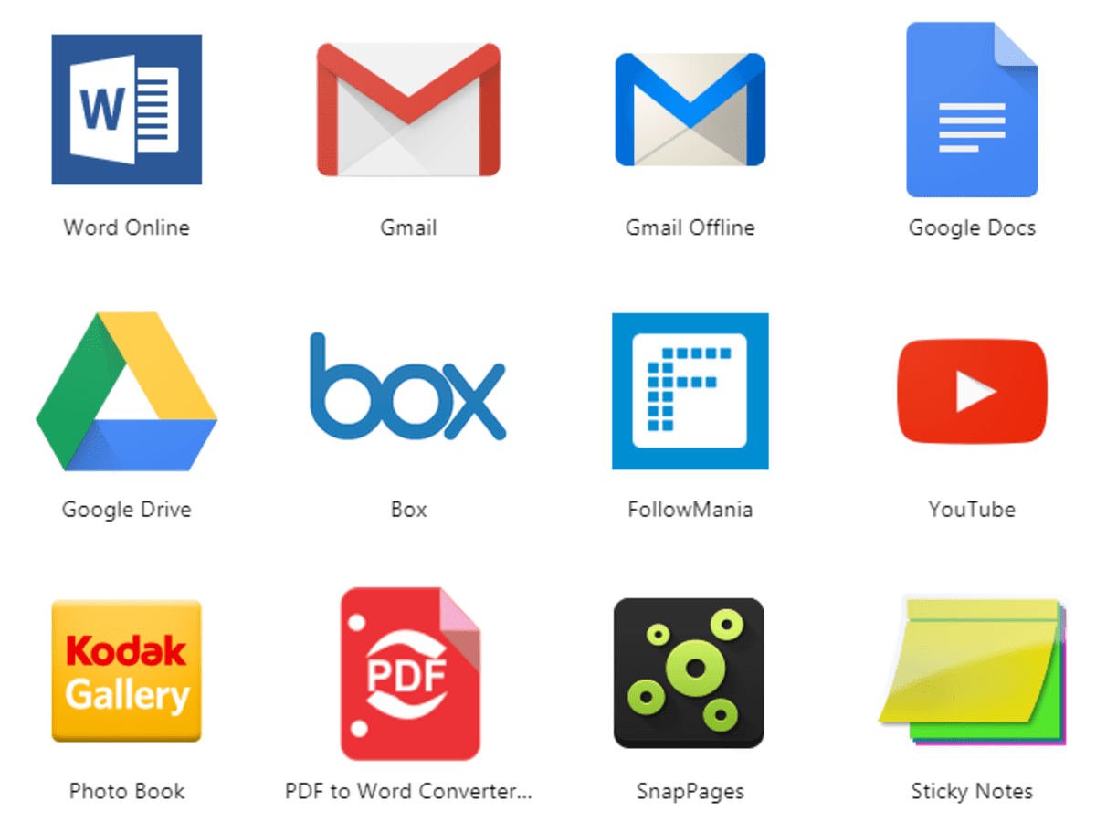
Types of software:
1. Application Software:
Application software is a software program or group of programs designed for end-users. There are many types of application software.
Types of Application Software and Examples
Word Processing Software: Google Docs, Microsoft Word, WordPad and Notepad
Database Software: MySQL, Oracle, and FoxPro
Spreadsheet Software: Google Sheets, Apple Numbers and Microsoft Excel

Slide 5
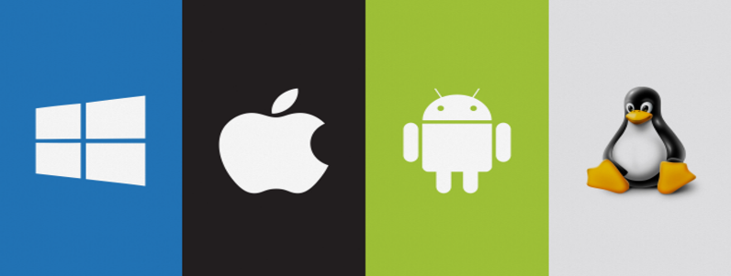
System Software:
System software provides a platform for other software and includes the programs managing the computer itself, such as the computer’s operating system, file management utilities and disk operating system (or DOS).
The system’s files consist of libraries of functions, system services, and drivers for printers and other hardware, system preferences and other configuration files.
While application software is non-essential and won’t shut down your device by being uninstalled, system software is essential and creates a platform that apps sit inside.
Examples of System Software
System software runs things in the background and operating systems are an example of system software.
For desktop computers, laptops and tablets:
Microsoft Windows
MacOS (for Apple devices)
Linux

Slide 6
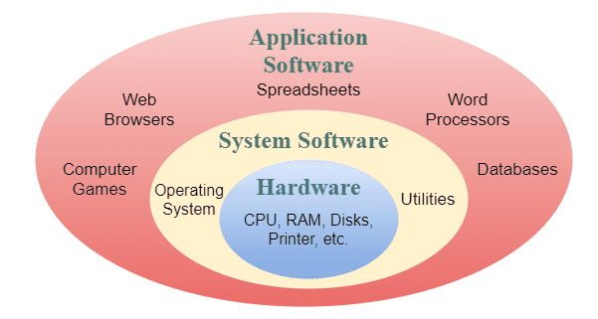

Slide 7
Attributes of Good Software
Maintainability: Software must evolve to meet changing need of customer is called maintainability. So, software should be written in such a way that, it may evolve changing needs of customer
Dependability: Dependability of software is a property of software that reflects it's trustworthiness. It is the degree of confidence, a user has that the system will operate as they expect and the system will not fail in normal use.
Portability: It refers to the ease with which software developers can transfer software from one platform to another.
Efficiency: Software should not make wasteful use of system resources such as memory, processor cycle. So, efficiency means, responsiveness, processing time, memory utilization.
Usability: Software must be easily usable, it should not be too complicated to use. It should have adequate, documentation and appropriate interface.

Slide 8
Software Engineering
Software engineering is the structured, systematic, and disciplined application of engineering principles to the design, development, testing, and maintenance of software. It goes beyond just writing code, encompassing the entire lifecycle of a digital product.

Slide 9
Importance of Software Engineering
Large software: It is easier to build a wall than to a house or building, likewise, as the size of software become large engineering has to step to give it a scientific process.
Scalability: If the software process were not based on scientific and engineering concepts, it would be easier to re-create new software than to scale an existing one.
Cost: As hardware industry has shown its skills and huge manufacturing has lower down the price of computer and electronic hardware. But the cost of software remains high if proper process is not adapted.
Dynamic Nature: The always growing and adapting nature of software hugely depends upon the environment in which user works. If the nature of software is always changing, new enhancements need to be done in the existing one. This is where software engineering plays a good role.
Quality Management: Better process of software development provides better and quality software product.

Slide 10
Fundamental process activities
Software Specification: The Requirements Engineering Process where engineers and stakeholders define system functions, constraints, and operational goals.
Design & Implementation: Translating specifications into the executable system. This includes architectural design, component design, database design, and the actual programming/coding.
Validation & Verification: Assessing the software to ensure it operates reliably and meets business and end-user requirements. This includes unit testing, integration testing, and bug fixing.
Evolution & Maintenance: Modifying and updating the software post-deployment to fix issues, adapt to new environments, or add new features based on changing market demands.

Slide 11
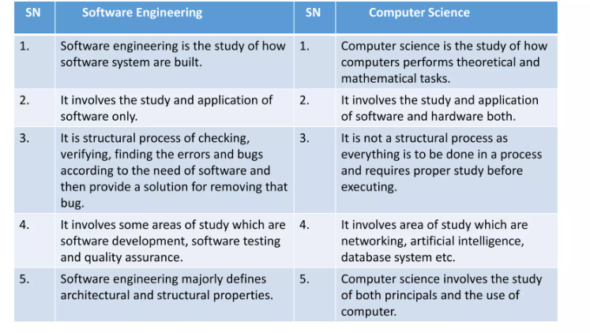
Software engineering vs computer science

Slide 12
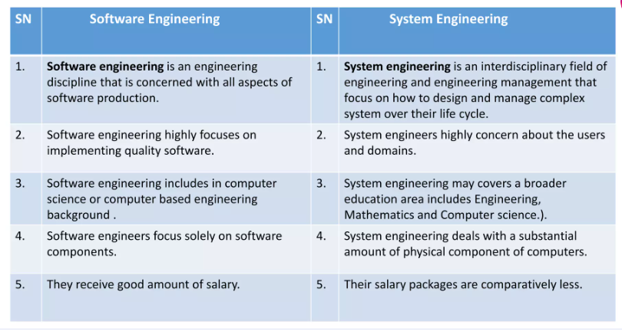
Software engineering vs system engineering

Slide 13
Challenges of software engineering
1. The legacy Challenge
The Legacy challenge refers to the challenge of continuously updating the software to meet the changing requirements of the user. We know that measure of popular software like Windows, Adobe, Android, Kaspersky, etc are very old and popular software but their demand is still the same. This is because they are successful in updating their software with the changing needs of generations. The Legacy challenge is the challenge of maintaining and updating the software in such a way that maximizing cost are avoided and important services regularly delivered.
2. Heterogeneity Challenge
Heterogeneity challenges refers to the difficulty faced by the developers to build platform-independent software which is flexible enough to cope with changes in the platform. Software development challenges are ever going problems for developers because Technology never is top in one development phase. The best solution to this challenge is to update programming techniques and go with the trends. Example :we should develop software which can be run in both mobile phone and desktop.

Slide 14
Challenges of software engineering
3. The Delivery Challenge
The delivery challenge is the challenge of the shortening delivery timing of extremely large and structured systems without compromising system quality. Finishing software development on time is one of the key challenges facing software engineering. Today businesses are rapidly changing and programmers need to achieve this software quality equally rapidly to the business.
4. Trust Challenge
Software is now participating in critical aspects of human life. Humans cannot take risks to thei life by using untrustworthy software. Making clients satisfied and even their trust is one of the key challenges facing software developers. It is also necessary for us that we can trust our software. This trust challenge is emerging as a threat in software engineering because of unreliable software services provided by the company. To be sustainable in the software market the developer must win the trust of users. So, the trust challenge is to develop a methodology that indicates software can be trusted by its users.
5. Risk Challenge
In safety-critical areas such as space, aviation, nuclear power plants, etc. the cost of software failure can be massive because lives are at risk. Dealing with the increased complexity of software needed for new applications.

Slide 15
Cost of software engineering
There is no simple answer to this question as the distribution of costs across the different activities in the software process depends on the process used and the type of software that is being developed.
For example, real-time software usually requires more extensive validation and testing than web-based systems.
So, roughly 60 percent of costs are development costs and 40 percent are testing costs. For customer software evolution costs often exceeds development costs.
Distribution of costs depends on development model that is used.

Slide 16
Professional software development and ethical responsibility
Professional responsibility in software engineering encompasses the ethical, legal, and social obligations of developers. It requires prioritizing public safety, maintaining data privacy, writing reliable code, and continuously updating skills. Engineers must balance employer needs with societal impacts, ensuring transparency regarding system limitations.
Software Engineering must persist following ethical responsibility for professional software development:
Confidentiality: Engineers must protect sensitive information belonging to their employers, clients, and projects.
Competence: Professionals should only accept tasks within their skill set and be honest about their limitations.
Intellectual Property: Respecting copyright, patents, and local laws regarding the use and export of software is mandatory.
Computer Misuse: Software must be used ethically; misuse, such as installing unauthorized software on employer systems, is considered unprofessional.

Slide 17
Diversity in software engineering
Software engineering is a systematic approach to development of software that takes into account practical cost, schedule and dependability issues. There are no universal software engineering methods and techniques that are suitable for all systems and all companies; rather diverse set of methods and tools has evolved. There are many different types of application diversity.
Standalone Applications: These are applications that run on a local computer such as PC; do not need to be connected to network. E.g. office package, CAD, Photo manipulation etc.
Interactive transaction based application: These are applications that execute on a remote computer and that are accessed by users from their own PCs or terminals. They include business applications such as e- commerce applications.
Embedded control system: These are software control systems that control and manage hardware devices. Example: software in mobile phones, software in microwave oven system to control cooking process.
Batch processing system: these are business systems that are designed to process data in large batches. Example: phone billing systems, salary payment systems.
Entertainment system: these are systems primarily for personal use and entertain the user. Example: Gaming software.

Slide 18
Internet and software engineering
The internet is now a platform for running application and organizations are increasingly developing web applications rather than local system. Internet service allows application functionality to be accessed over the internet. With the help of internet, instead of writing software and deploying it on users PC, the software can be developed on web server that can be accessed through browsers. This made it much cheaper to change and upgrade the software as there was no need to install the software on every PC. Now a day you get every services using cloud computing technology. This is an approach to the provision of computer services where applications run remotely on the cloud. In cloud computing users do not buy software but pay according to how much the software is used or are given free access in return.

Slide 19
Software Types:
Generic: These are the systems used for developing a general purpose software. From design and marketing perspective This king of development is very difficult has large number of users the may be using this kind of software. Development team controls the process of generic software development. Word editing software is its example.
Custom: These are the systems used. for developing a software product as per the needs of particular customer. This development does not require marketing because it is developed for appropriate group of users. Customers determines the process of software development un this type of product, Control system for electronic device is its example

Slide 20
CASE (Computer-Aided Software Engineering)
A CASE (Computer-Aided Software Engineering) tool is a software application that supports one or more software development processes. CASE tools are designed to automate or semi-automate various software development tasks, such as design, coding, testing, and project management.
CASE tools can help organizations and software developers to improve the quality and efficiency of their software development processes. They can help to minimize the likelihood of errors, reduce development time and cost, and improve collaboration among team members.

Slide 21
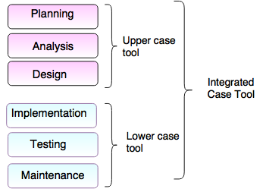
CASE (Computer-Aided Software Engineering)

Slide 22
CASE (Computer-Aided Software Engineering)
Upper Case Tools - Upper CASE tools are used in planning, analysis and design stages of SDLC.
Lower Case Tools - Lower CASE tools are used in implementation, testing and maintenance.
Integrated Case Tools - Integrated CASE tools are helpful in all the stages of SDLC, from Requirement gathering to Testing and documentation.

Slide 23
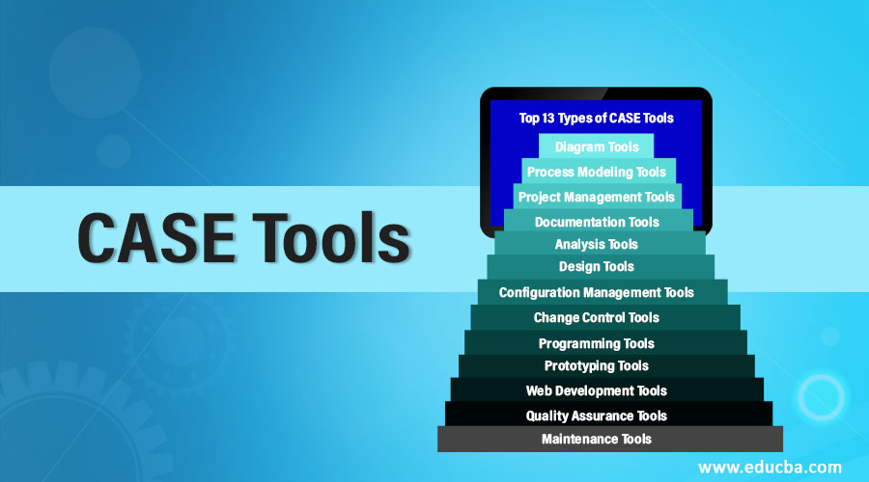
CASE (Computer-Aided Software Engineering)

Slide 24
Exercise
1. What is software? Explain different types of software with example.
2. Differentiate between generic and bespoke software product.
3. Explain the attributes of good software.
4. What is software engineering? How does it different from computer science?
5. What is software process? Differentiate between software engineering and system engineering.
6. What is CASE? Explain the importance of CASE tools in software development life cycle.
7. Explain challenges facing software engineering along with professional and ethical responsibilities.
8. Why software testing costs are high for generic software product? Explain.
9. What do you mean by software engineering diversity? Explain with example.

Slide 25
End of unit 1

